Slide 1
Lists
CSCI 1101 – Introduction to Programming in Python

Slide 2
Lists
In Python, Lists allow you to store multiple literal values in a single variable. For example, if you want to store the names of various grocery items you can use a list.
grocery_list = [ “Eggs”, “Milk”, “Bread” ]

Slide 3
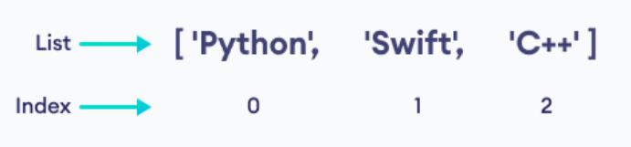
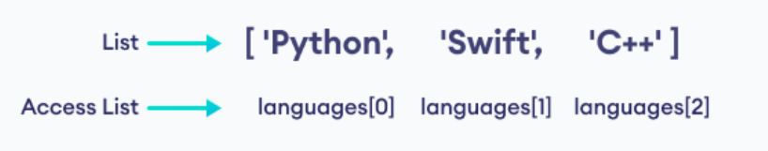
Accessing List Elements
Each element in a list is associated with a number known as an index. The index of a list always starts at 0.
The index is used as a key to access the element associated to it.
languages = [ “Python”, “Swift”, “C++” ]
print( languages[ 0 ] ) # will output “Python”

Slide 4
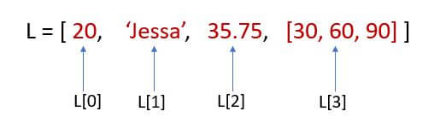
List Characteristics
Ordered: Elements in a list are ordered by their index.
Changeable: Elements in a list can be changed or removed.
Heterogeneous: Elements in a list can be of different types (including List).
Allows Duplicates: Elements in a list can be duplicates but will have different index.

Slide 5
List Splicing
To print out the entire list you can simply use the print() method.
my_list = [ “dog”, “cat”, “bird”, “fish”, “hamster” ]
print( my_list ) # will output [ “dog”, “cat”, “bird”, “fish”, “hamster” ]
To print a portion of the list we can use the splicing operator : . Simply indicate the start and ending index.
my_list = [ “dog”, “cat”, “bird”, “fish”, “hamster” ]
print( my_list[ 0 : 2 ] ) # will output [ “dog”, “cat” ]
print( my_list[ 2 : 4 ] ) # will output [ “bird”, “fish” ]

Slide 6
Adding Elements to List
To add new elements to a list you can use the append() method. Appended elements are added to the back of the list.
my_list = [ “dog”, “cat” ]
print( my_list ) # will output [ “dog”, “cat” ]
my_list.append(“bird” )
print( my_list ) # will output [ “dog”, “cat”, “bird” ]

Slide 7
Adding Elements to Specific Index in List
To add new elements to a list but into a specific index, you can use the insert() method. Inserted elements are added to the specified index and all other elements are pushed back.
my_list = [ “dog”, “cat”, “bird” ]
print( my_list ) # will output [ “dog”, “cat”, “bird” ]
my_list.insert( 2, “hamster” )
print( my_list ) # will output [ “dog”, “cat”, “hamster”, “bird” ]

Slide 8
Changing List Elements
To update an element in a list you can simply use the [ ] access operator to specify the index of the element and then use the = assignment operator to update the element.
my_list = [ “dog”, “cat”, “bird” ]
print( my_list ) # will output [ “dog”, “cat”, “bird” ]
my_list[ 1 ] = “lizard”
print( my_list ) # will output [ “dog”, “lizard”, “bird” ]

Slide 9
Removing List Elements
To remove elements from a list you can use the del statement. The del statement can be used to remove a single element, multiple element, or the entire list.
my_list = [ “dog”, “cat”, “bird”, “fish”, “hamster” ]
print( my_list ) # will output [ “dog”, “cat”, “bird”, “fish”, “hamster” ]
del my_list[ 1 ]
print( my_list ) # will output [ “dog”, “bird”, “fish”, “hamster” ]
del my_list[ 1 : 3 ]
print( my_list ) # will output [ “dog” , “hamster” ]
del my_list
print( my_list ) # will output Error, list no longer exists

Slide 10
Getting the List Length
To get the length of a list or the number of elements in a list, you can use the len() function.
my_list = [ “dog”, “cat”, “bird” ]
print( len( my_list ) ) # will output 3

Slide 11
Iterating Through a List
To print the entire list, you can simply use the print() function. However, if you wish to iterate through a list to either print the elements individually or access each element individually, you can use a for loop.
my_list = [ “dog”, “cat”, “bird” ]
for item in my_list :
print( item )

Slide 12
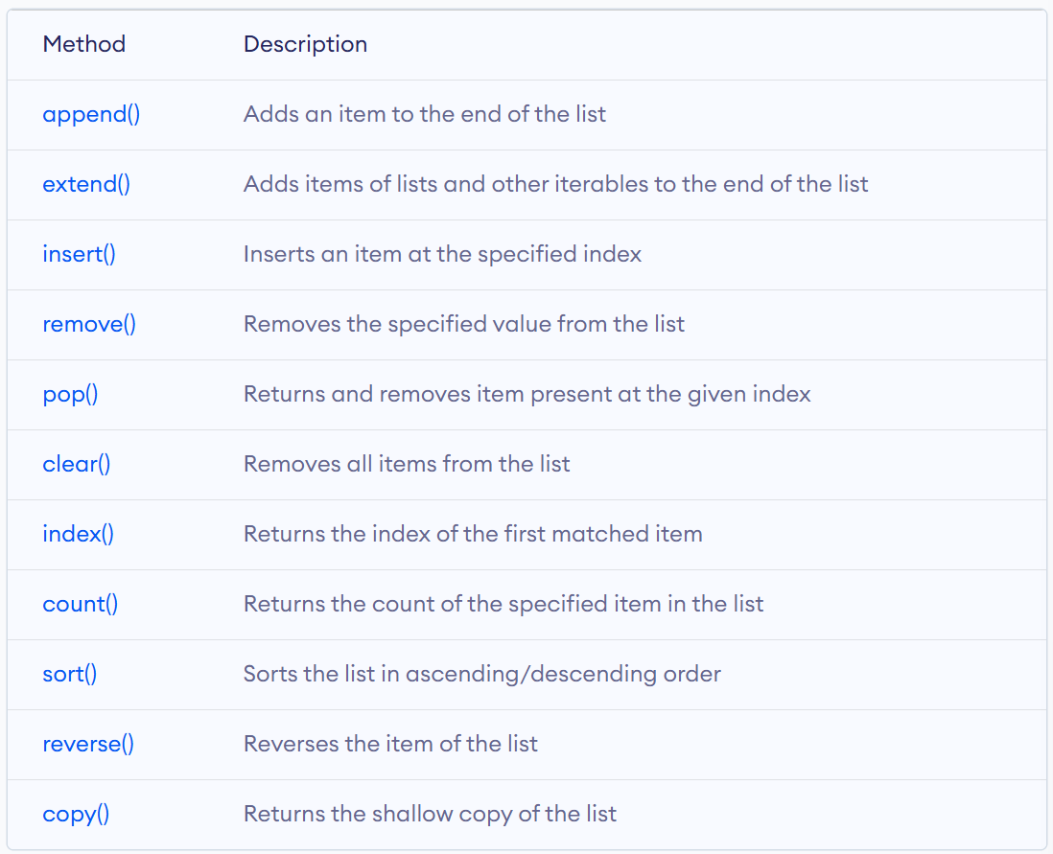
Python List Methods

